Slide 1
How to fill out the Parent’s Financial Statement
Section 4 – Assets and Liabilities

Slide 2
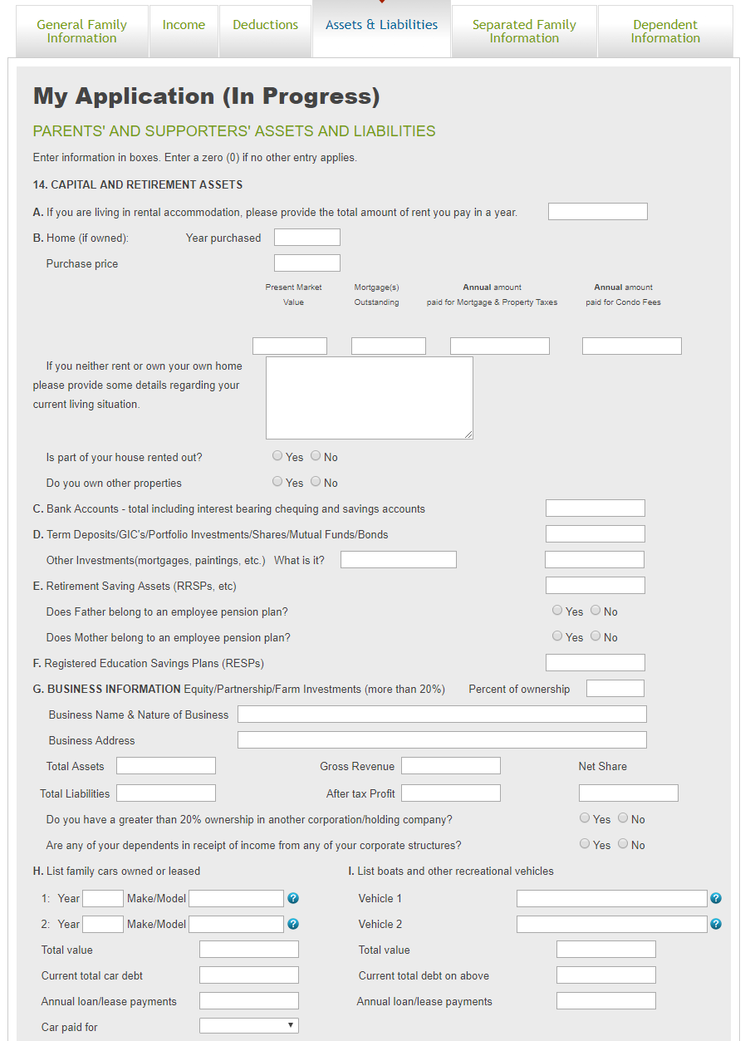
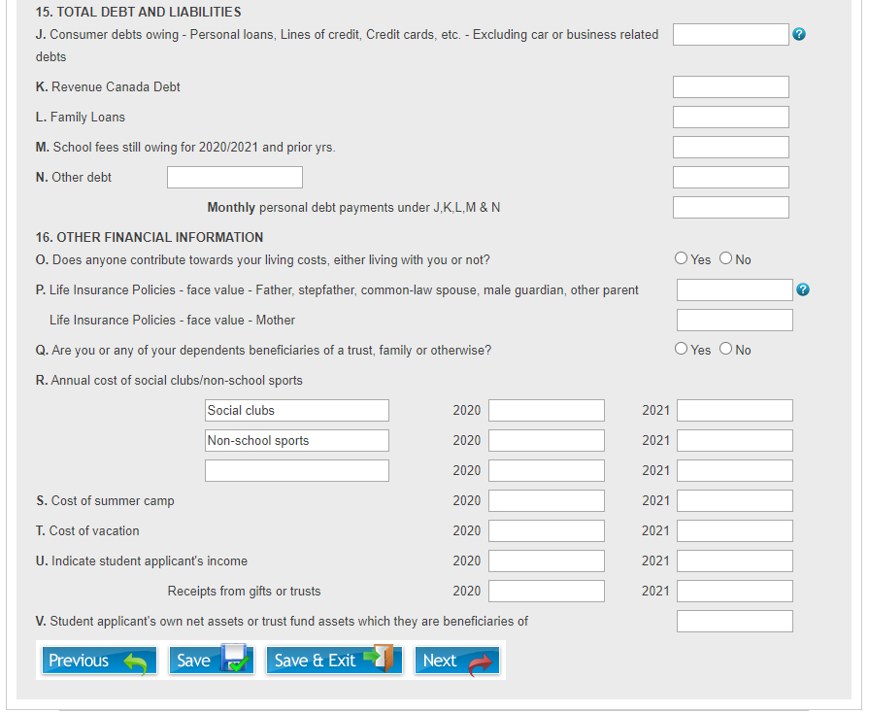
Assets and Liabilities
On the “Assets and Liabilities” tab of the application, information will be collected related to all assets and liabilities that describes the families’ financial situation.

Slide 3
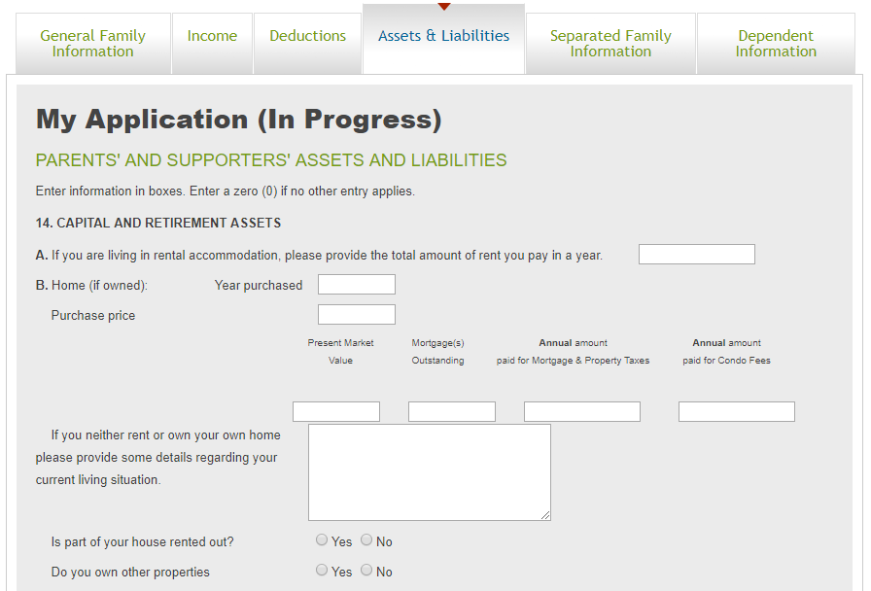
Assets and Liabilities - 1
Section 14 – A
  Enter the total yearly amount that you pay for rent if living in rental accommodations
Section 14 – B
  If you own a home, enter the: Year purchased, purchase price, present market value (estimate), outstanding mortgage amount and the annual amounts paid for mortgage payments & property taxes and condo fees
  If you have a mortgage listed above, you will need to upload the most recent copy of a bank provided mortgage statement on the uploads page at the end of the application
  NOTE: If you do not pay rent or own a home, a box will open to allow you to provide some details around your current living situation
  NOTE: If you both own a home that is not rented out, and pay rent, a box will open requesting further details around your living situation.
  If part of your house is rented out, select “Yes”, otherwise select “No”
  If part of your house is rented out, the rental income should be noted on the Income tab in Section 10 I. For any rental income, you will also need to upload a copy of your most recent T776 Statement of Real Estate Rentals that would have been filed as part of your most recent tax return
  If you own other properties, select “Yes” and another section will pop up with the same sections as above and allow you to provide details on the additional properties
  For any mortgages that are associated with these other properties, we will require a bank provided mortgage document as per above.

Slide 4
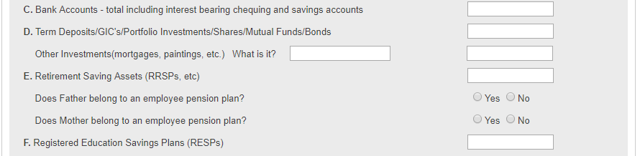
Assets and Liabilities - 2
Section 14 – C
  Enter the total amount of assets in your bank accounts
Section 14 – D
  Enter the total amount of assets you own in Term Deposits/GIC’s/Portfolio Investments/Shares/Mutual Funds and/or Bonds
  If you have other investments, describe them in the leftmost box, and provide a value in the rightmost box
Section 14 – E
  Enter the total amount of funds and/or assets you have as Retirement Saving Assets
  Select “Yes” if either individual belongs to an employee pension plan, otherwise select “No”
Section 14 – F
  Enter the total amount of funds you have invested in Registered Education Savings Plans for all your dependants

Slide 5
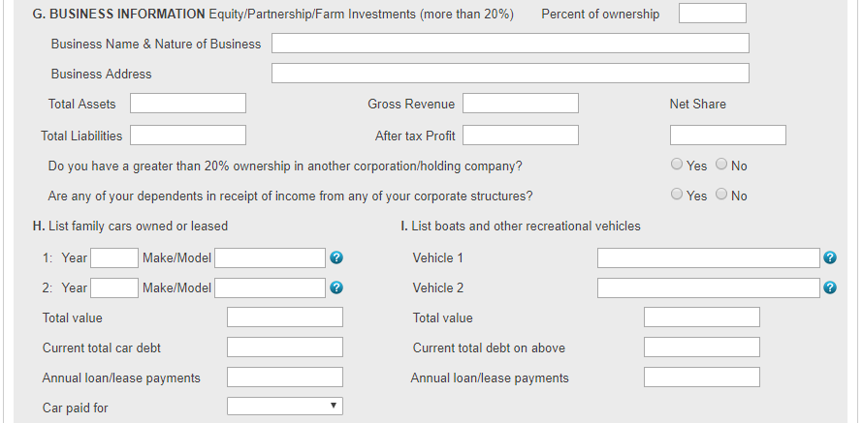
Assets and Liabilities - 3
Section 14 – G
  Enter the Name, Address, Total Assets, Liabilities, Gross Revenue and After Tax Profit as well as your net share and percent of ownership in any corporations that you own.
    These amounts can be taken either from your formal financial statements, or GIFI schedules 100 & 125 that are part of your corporate tax returns
  For all corporations where you own 20% or more, you will have to upload a copy of their most recent financial statements on the upload page at the end of the application
  If you have 20% or greater ownership in another corporation or holding company, select “Yes”. Another section will open below allowing you to enter the information for that business. Up to 4 corporations can be entered here. If you own more than 4 corporations, please provide the same information for the additional corporations as an Explanatory Note
  If any of your dependants receive income any of your corporations, select “Yes” and a box will open to allow you to provide details on the amount and type of income that they receive. You will also need to upload their most recent Notices of Assessment on the upload page at the end of the application
Section 14 – H
  List the year and make/model for all cars and/or other vehicles owned
  List the total market value of these vehicles
  List the total debt still remaining on the listed vehicles
  List the annual amount paid in loan and/or lease payments
  If any amount listed in this section, a drop-down list will appear allowing you to select if these vehicles were paid for personally, or by any business which you have ownership in

Slide 6
Assets and Liabilities – 4
Section 15 – J
  Enter the total amount of consumer debt currently outstanding (credit cards, personal loans, lines of credit, etc..)
  NOTE: Depending on the amount of consumer debt noted in this section, you may need to upload copies of your debt statements (i.e credit cards, line of credit, etc..) showing the total amount of debt owed on the upload page at the end of the application
Section 15 – K
  Enter the amount of personal debt owed to Revenue Canada
Section 15 – L
  Enter any amount of Family Loans that are still outstanding
Section 15 – M
  Enter any amount of School Fees that are still owed for previous academic years
Section 15 – N
  Enter details about any other debt in the leftmost box and the amount in the rightmost box
Section 16 – O
  Select “Yes” if anyone not referenced previously on the application contributes towards your living costs. Otherwise select “No”. If “Yes” is selected, a box will appear to allow you to provide details on that other individual as well as the amount that they contribute
Section 16 – P
  Enter the total face value amount of any Life Insurance Policies that you pay for. This is the amount payable upon the death of the insured

Slide 7
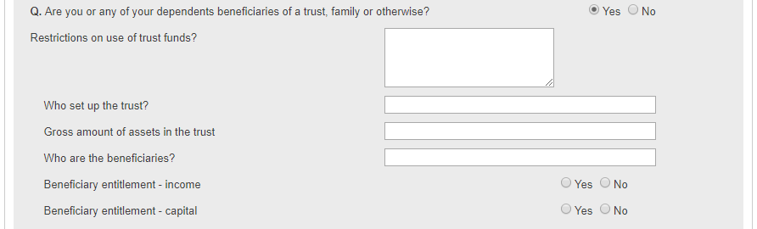
Assets and Liabilities – 5
Section 16 – Q
  Select “Yes” if you or any of your dependents are beneficiaries of a trust. Otherwise select “No”.
  If “Yes” is selected, additional boxes will appear to allow you to provide additional information
  Fill in any restrictions that may exist on the use of the trust funds
  Provide details on the individual(s) who set up the trust
  Enter the total amount of assets that are in the trust
  Enter the name(s) of the beneficiaries of the trust
  If only the income from the trust is accessible to you, select “Yes” on Beneficiary entitlement – income
  If you can draw on the capital assets in the trust in addition to any income from them, select “Yes” on Beneficiary entitlement – capital

Slide 8
Assets and Liabilities – 6
Section 16 – R
  Enter any annual amounts that you pay towards the below.
    Social clubs i.e. Gym memberships, Boy/Girl Scouts, Country clubs, etc..
    Sports teams (Non-school related) that the family pays for i.e. Hockey teams/camps, Football teams, etc..
    Any other activities that the family pays towards. Please describe the activity in the leftmost box
Section 16 – S
  Enter the total cost of any summer camp(s) in the previous year as well as the projected cost for the next year
Section 16 – T
  Enter the total cost of any vacation(s) in the previous year as well as the projected cost for the next year
Section 16 – U
  Enter any income for the student applicant(s) for the previous year as well as the projected year.
  If any income was earned in the previous year, you will need to upload their most recent Revenue Canada Notices of Assessment on the upload page at the end of the application
  Enter any amount that the student applicant received from gifts or from trusts in the previous year as well as the projected year
Section 16 – V
  Enter the total assets that the student applicant owns, and/or the total trust fund assets that the student applicant is the beneficiary of.

